Slide 1
Traditional Japanese Food
CĂTĂLIN PLEȘU

Slide 2
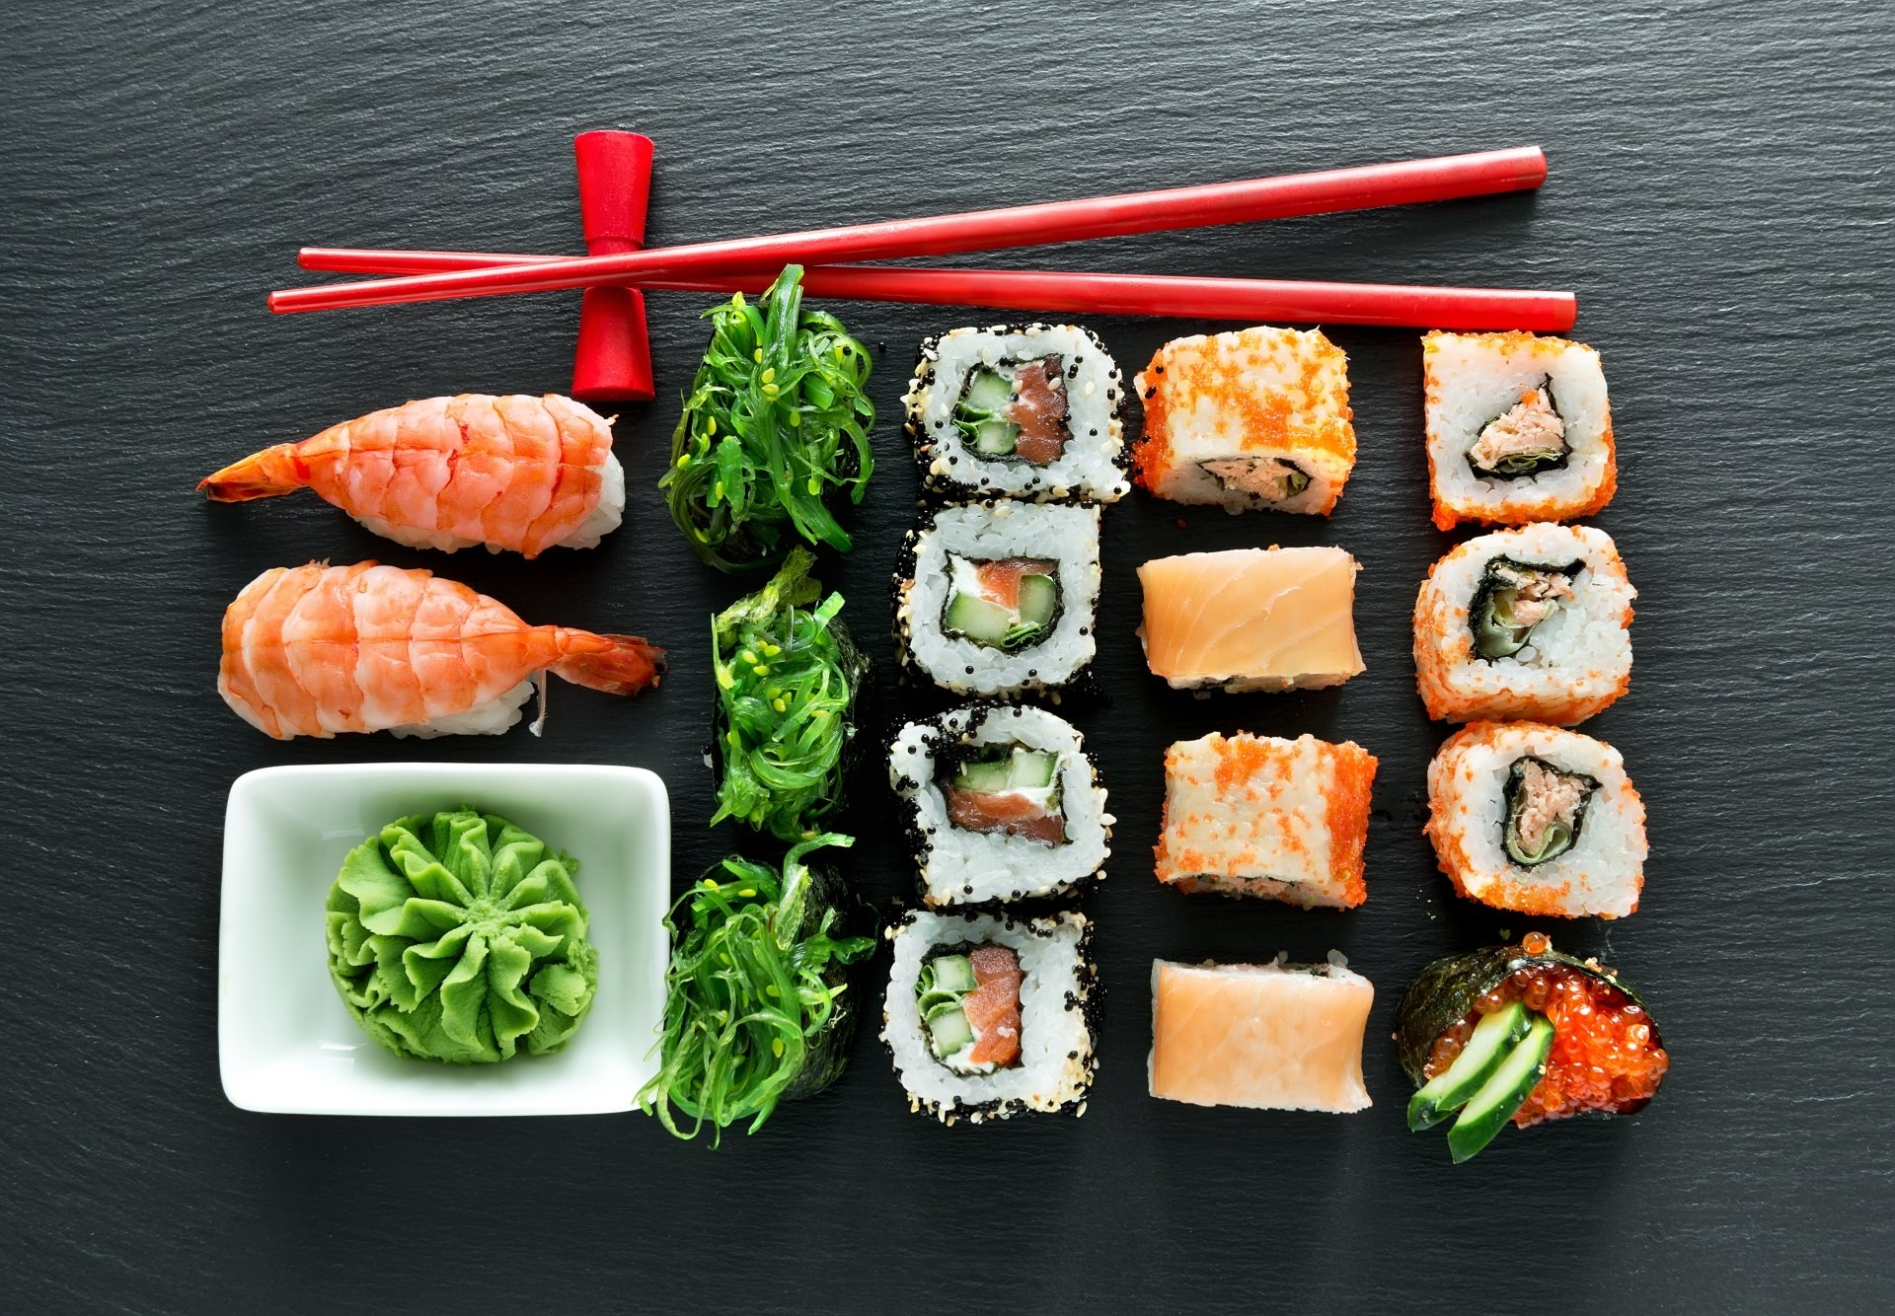
Sushi
Sushi is one of the best known Japanese foods around the world. It is offered in various ways and prices. Sushi can be eaten with chopsticks or directly with your hand.

Slide 3
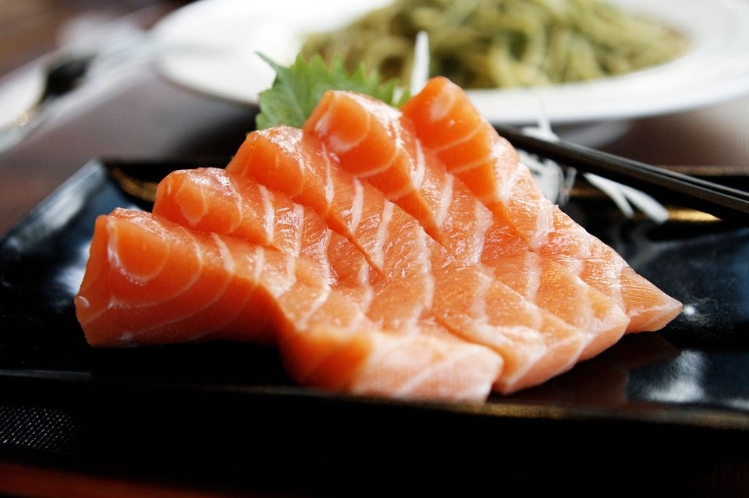
Sashimi
Sashimi is another must-try food. Similar to sushi but without the rice, sashimi is raw fish sliced into easy-to-eat pieces. The high-quality of the fish caught in all regions of Japan makes it a great choice no matter if you are visiting Tokyo, Kyoto, or anywhere else.

Slide 4
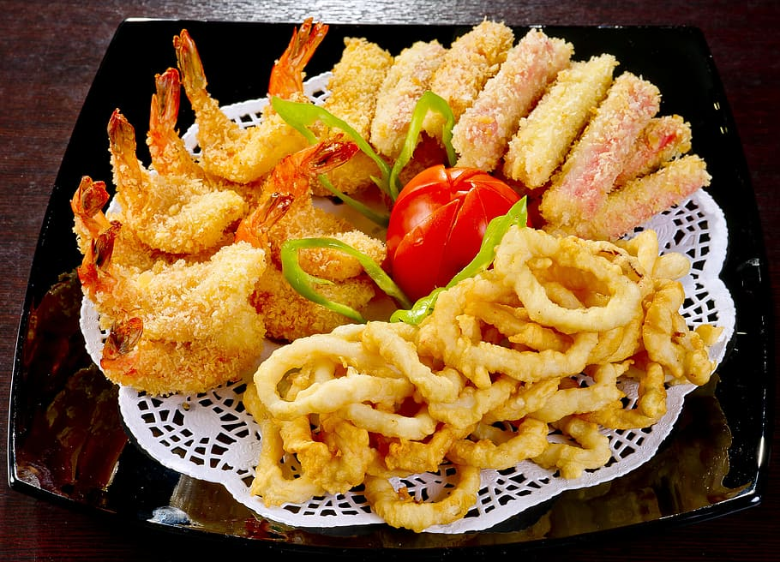
Tempura
Tempura is a dish involving ingredients like seafood, meat, and vegetables covered in batter and deep-fried in oil. The batter usually contains flour and egg. Tempura is generally dipped in a special sauce called tentsuyu before eating.

Slide 5
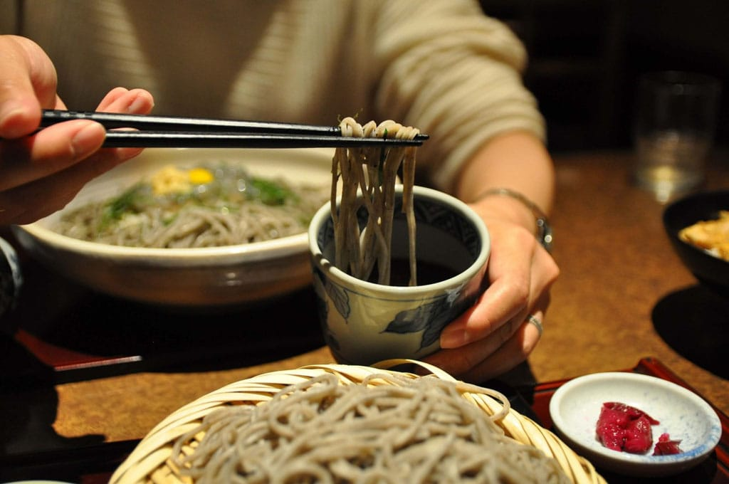
Soba - Buckwheat Noodles
Soba is a noodle dish made from buckwheat flour with water and flour, thinly spread and cut into noodles with widths of 1cm-2cm. After boiling the noodles in hot water, it is eaten dipped in cold soup, or by pouring hot soup over it.

Slide 6
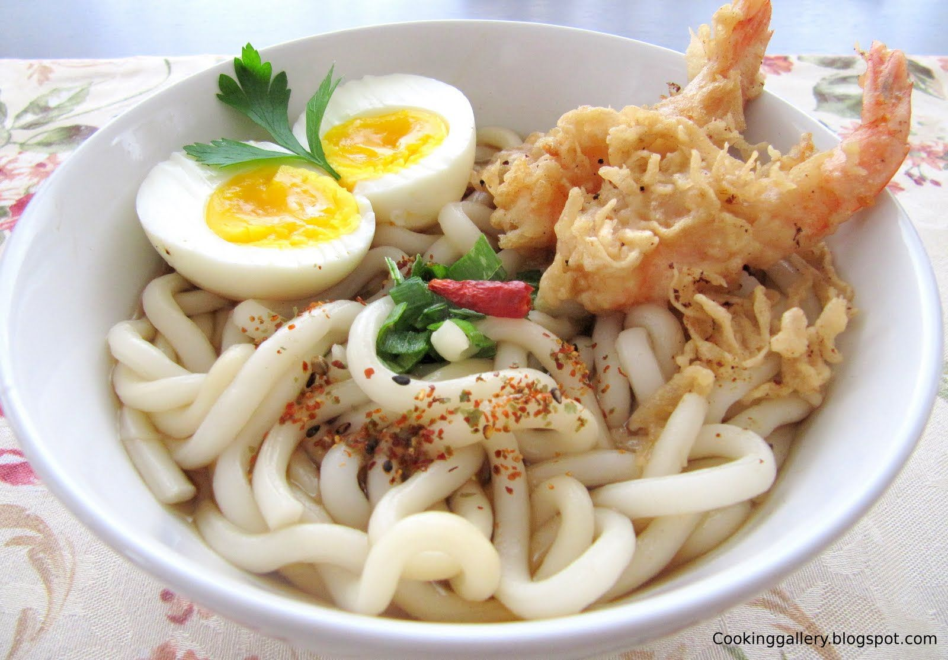
Udon
Udon is a unique dish known for its thick noodles, and is a very popular and traditional Japanese dish. The dough is made from flour and salt water that is well-kneaded and cut into noodles. After udon noodles are boiled in hot water, udon is enjoyed in seafood broth soup, or by pouring soup and toppings like tempura on top of it. Like soba, you can savor udon hot or cold. There is no one designated way to eat udon.

Slide 7
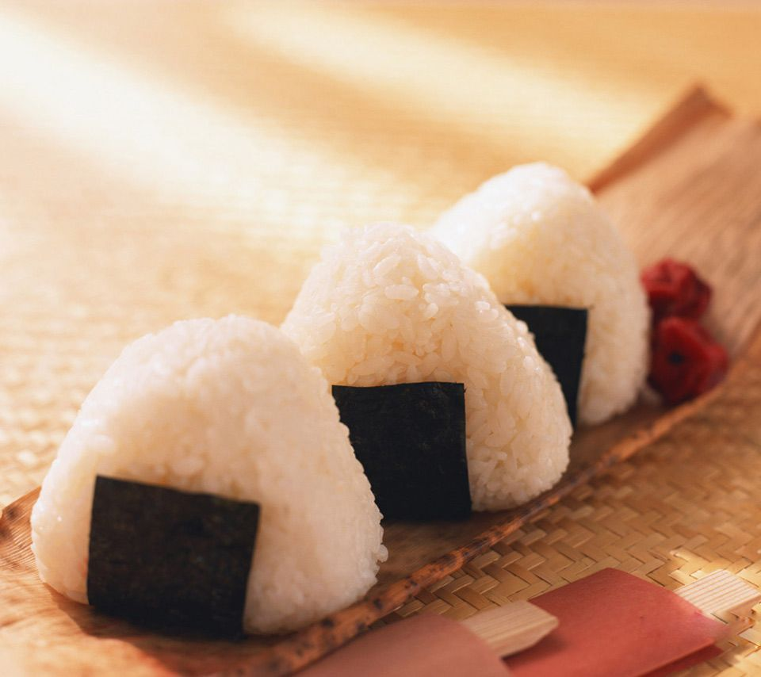
Onigiri - Rice Balls
You may have heard of onigiri, or rice balls, before. Onigiri, also called omusubi, may just look like plain rice, but they often have a savory filling inside and are wrapped with a salty sheet of nori seaweed.

Slide 8
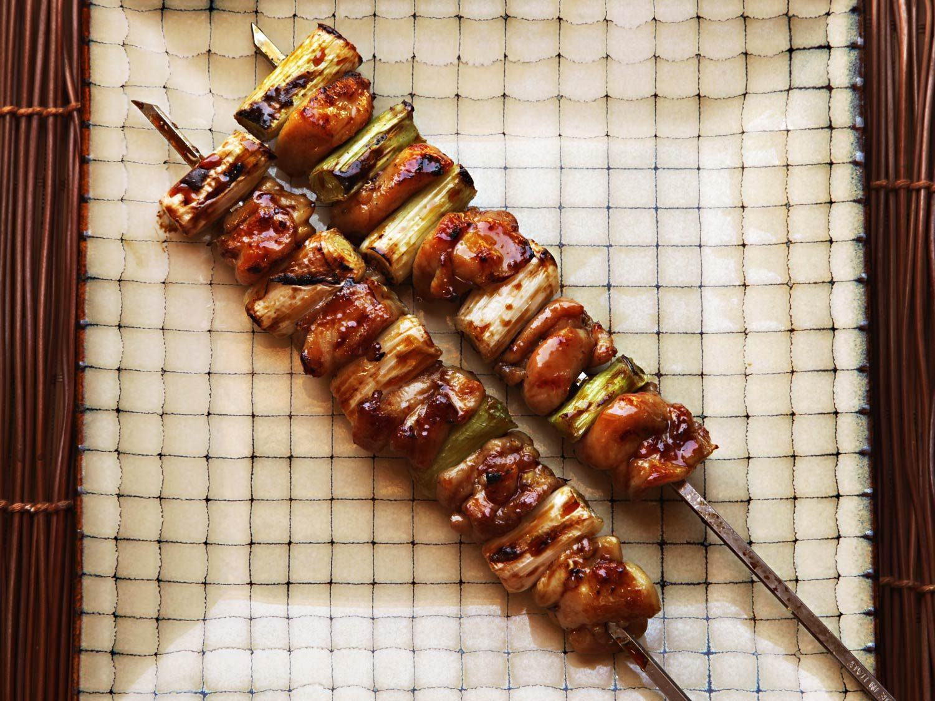
Yakitori - Grilled Chicken Skewers
Yakitori is a popular food where chicken is cut into small pieces, then placed on bamboo skewers and grilled. It is often found on the menus of izakaya and casual restaurants, making it a good option for a night out in Japan with friends.

Slide 9
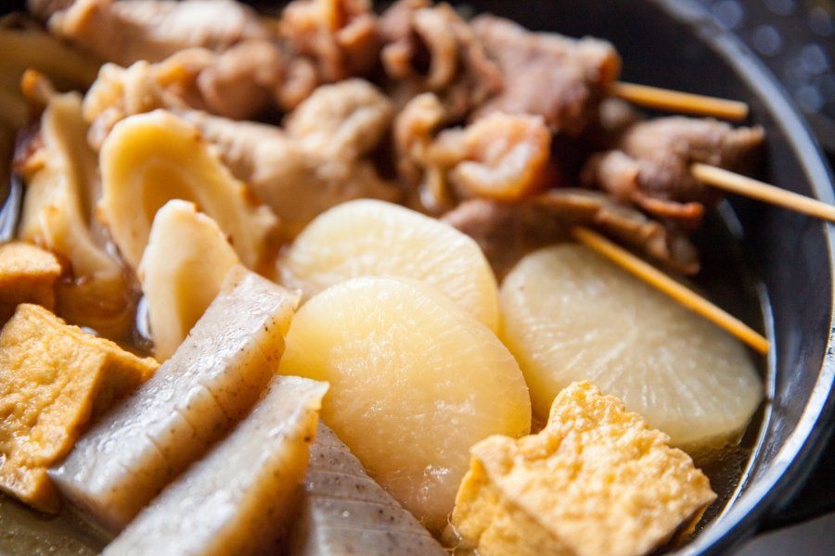
Oden
Oden is dish of various ingredients simmered in broth. Mild-tasting vegetables, tofu, and fish are common ingredients in oden. Daikon radish, a thick root vegetable, can be found at most shops with oden.

Slide 10
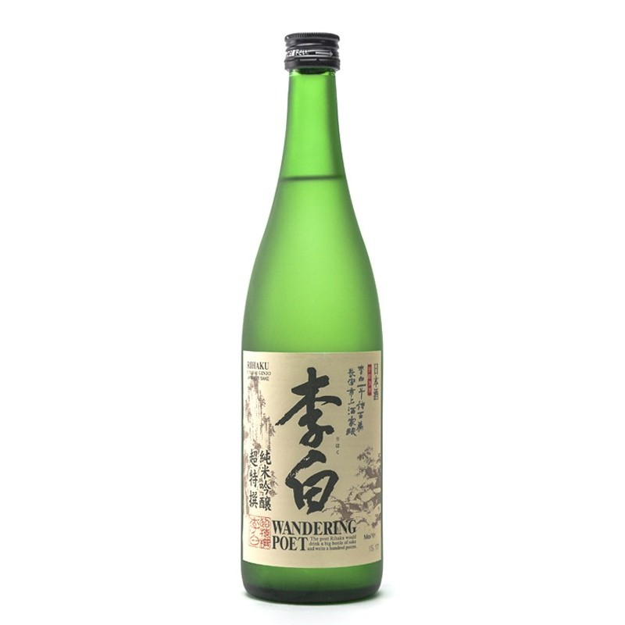
Sake (Rice Wine)
Commonly called sake outside of Japan, nihonshu or sake (note that "sake" is also the general Japanese term for alcohol) is brewed using rice, water and koji mold as the main ingredients. Besides major brands, there are countless local rice wines (jizake). The alcohol content of nihonshu is typically about 10-20 percent. It is drunk either hot or cold, and it is usually filtered although unfiltered nihonshu is also available.

Slide 11
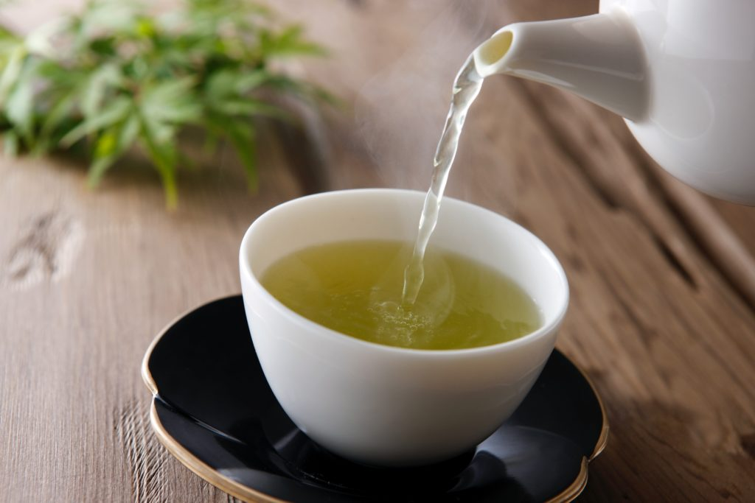
TEA
Tea is the most popular beverage in Japan and an important part of Japanese food culture. Various types of tea are widely available and consumed at any point of the day. Green tea is the most common type of tea, and when someone mentions "tea" (お茶, ocha) without specifying the type, it is green tea to which is referred. Green tea is also the central element of the tea ceremony. Among the most well-known places for tea cultivation are Shizuoka, Kagoshima and Uji.

Slide 12
Vocabulary
Seafood - shellfish and sea fish, served as food.
Buckwheat – Hrişcă – GRECIKĂ
well-kneaded - bine frământat
Skewers – frigarui
Tofu - s a food prepared by coagulating soy milk and then pressing the resulting curds into solid white blocks of varying softnes
お茶, ocha – greem tea

